Slide 1


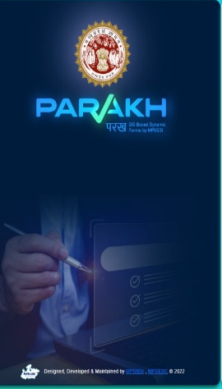
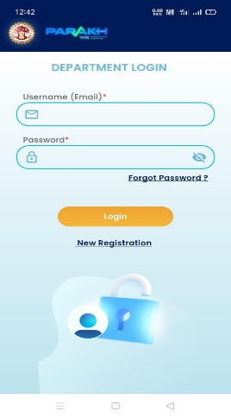
Tetra Pack Milk Distribution Application
Sehore District Collectorate, MP
Features & Usage
Parakh’s framework is proposed to build solution for Tetra Pack Milk Distribution Application for Sehore district using Vision AI.
Tetra Pack Milk Distribution application will enable
Objective: Increase Transparency, Log analysis, Automated Report generation, Continuous Monitoring, Improvement and Continuous Delivery, and Log Popular Milk Flavour Variant.
The POC for Anganwadi, School shall distribute Tetra Milk packs to specified Schools and Anganwadi. Vision AI capture Student group photo evidence for Head count verification and can also capture Tetra Milk Packet Photo, Count and Date and get it verified by Vision AI.
The Administrative workflow model describes complete end-to-end flow for this application.

Slide 2
Tetra Pack Milk Distribution Administrative Steps
Initiation: Tetrapack milk distribution planned for 5 schools and 5 Anganwadis.
Objective: Increase transparency, log analysis, and monitor delivery.
Database Creation: Student database records fetched from respective School or Anganwadi.
Teacher Distribution: Teachers distribute milk, capture IDs and group photographic images.
Teacher Capture Group Picture of Students: Student headcount via image / Verification by Vision AI.
Evidence Collection: Photos of milk tetra pack, group student photos, and disposal records (including garbage and wastage).
Variety & Feedback: Track distribution of 5 flavours; log popular variants.
Data Analytics: Count packs, sync group photos, collect data for analysis, use Vision AI for headcount verification.

Slide 3
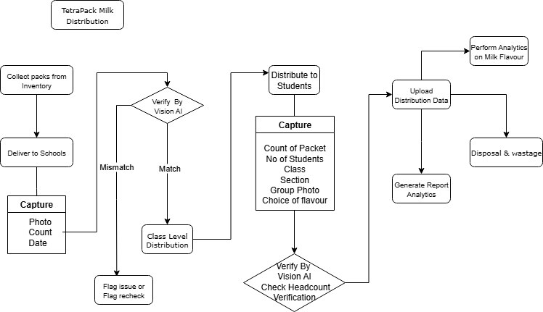
Tetra Pack Milk Distribution Administrative Workflow

